Slide 1
WorldVisitz Mobile Application Agile Delivery Launch
Agile Onboarding - Presentation for the Agile Team
Presented by: Salma Attia
© 2019 Udacity. All rights reserved.

Slide 2
Onboarding the Team

Slide 3
Agile Benefits for the Team
Benefit | What It Means for the Team
Clear Priorities | Team always knows what’s most important, reducing confusion and context switching
Faster Feedback | Developers, testers, and designers get early and regular feedback from stakeholders
Shared Ownership | Cross-functional teams share responsibility and decision-making, boosting morale
Predictable Workload | Time-boxed sprints help prevent burnout and support sustainable pace
Continuous Learning | Retrospectives, pair programming, and reviews enable skill growth and team maturity
Collaboration & Transparency | Daily standups and backlog visibility ensure everyone is aligned
Recognition of Contributions | Regular demos let team members showcase their work and feel valued
Notes:
Agile empowers the team—not just to deliver faster, but to own their work, collaborate more deeply, and grow professionally. In the WorldVisitz context, where developers are split across time zones, Agile will help break down silos, build trust, and foster a more collaborative, efficient, and motivated team environment.

Slide 4
Agile Practice

Slide 5
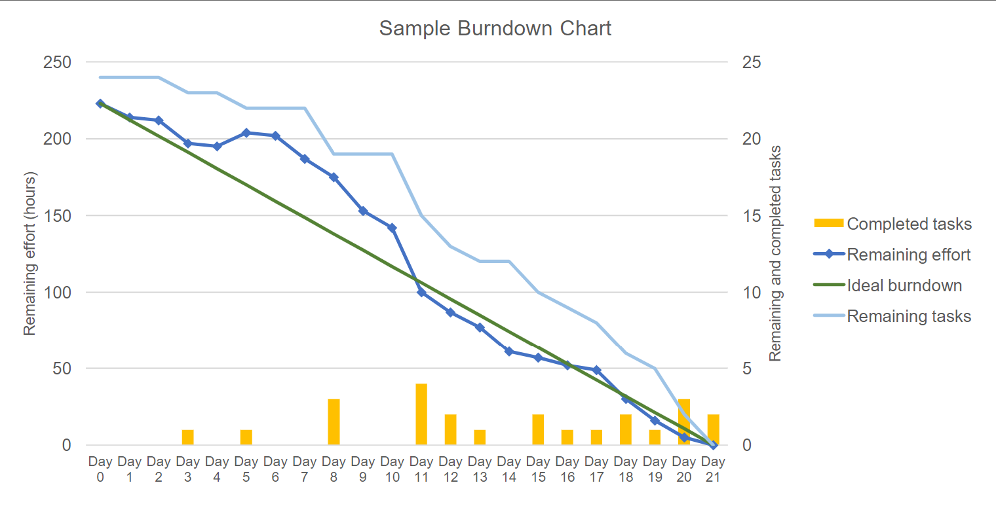
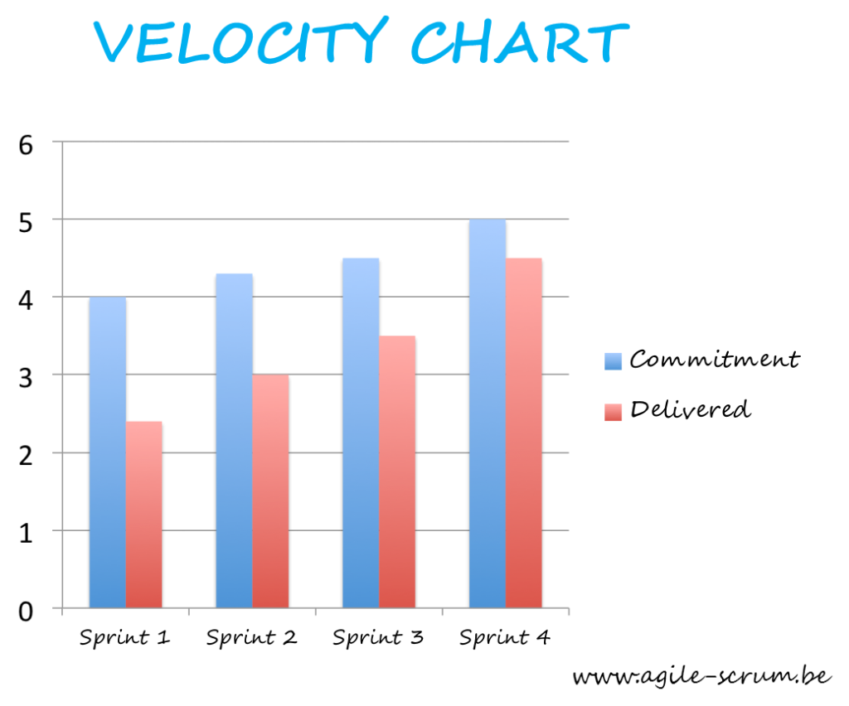
Recommendations for Information Radiators
Radiator | Visual Example | Value Proposition (Why It’s Helpful)
1. Sprint Burndown Chart | Line graph showing work remaining over days in sprint | - Tracks progress against sprint goals - Highlights risks early (e.g., scope creep, delays) - Keeps team focused on completion
2. Velocity Chart | Bar chart showing story points completed per sprint | - Measures team performance over time - Helps forecast future sprint capacity - Useful for sprint planning & stakeholder trust
Burndown Chart
Velocity Chart
Notes:
Our recommendation is a Burndown or Velocity chart. This radiator gives a quantitative picture of how the team is progressing toward completing the sprint goal. It shows if we're on track, ahead, or behind. It also helps in forecasting and planning future sprints more realistically. For stakeholders, it's a powerful visual that communicates progress at a glance

Slide 6
Ceremony Schedule & Each Agenda
Ceremony/Activity | Frequency | Duration | Purpose | Agenda
Project Vision | Project Start | Varies (Workshop) | Establish product purpose, customer needs, and success metrics. | Discuss the project goals identify sponsor outline project vision, success criteria, assumptions, constraints, and risks.
Sprint Planning | Start of Sprint | 2 hours | Define sprint goal, select backlog items, break into tasks. | Agile Team works with the PO and Scrum Master to address the following three questions: What are we committing to deliver in the upcoming Sprint? How will we complete the work required to achieve this commitment? What are the respective estimates for each user story and associated tasks?
Daily Scrum | Daily | 15 minutes | Team sync on progress, blockers, and next steps. | Three questions are addressed by each Team member : What did I do since the last time we met? What do I plan to accomplish today? What impediments am I encountering?
Notes:
The Daily Scrum is a quick team sync held every morning. It’s not a status report—it's a coordination meeting. The goal is to surface blockers and align on progress. Time-boxed to 15 minutes to keep it focused and energizing.
Sprint Planning kicks off the sprint. The Product Owner presents the top-priority items from the backlog. The team then discusses what they can realistically commit to. We define a Sprint Goal to stay focused and aligned.

Slide 7
Ceremony Schedule & Each Agenda
Ceremony/Activity | Frequency | Duration | Purpose | Agenda
Sprint Review | End of Sprint | 1 hour | Demo completed work, collect feedback, adjust backlog. | The Team demonstrates the Sprint’s incremental work to the PO and other business representatives. Then Team and PO transparently discuss accomplishments, as well as opportunities for improvement. After that PO determines if the Sprint deliverable are acceptable based on the Acceptance Criteria and Definition of Done.
Sprint Retrospective | End of Sprint | 1 hour | Reflect on process, identify improvements, and build team cohesion. | The Team also discusses what went well, as well as what to continue to doing that is working very well for the Agile Team in terms of delivering value. Create a plan for improvement Discuss what went well and what to continue doing
Release Planning | Sprint 0 & Quarterly | 1–2 hours | Define major features, timeline, and dependencies across multiple sprints. | Discuss critical dates and milestones. Coordinate with dependent departments and systems Balance business value vs quality.
Notes:
The Sprint Review is a chance to showcase completed work to stakeholders. It’s collaborative—stakeholders give feedback, which may influence the next sprint. It keeps development transparent and customer-focused.
The Retrospective is our team’s safe space to reflect. We talk openly about what worked and what didn’t. The most important part is identifying actionable improvements for the next sprint. This is how we grow as a team.
These ceremonies create rhythm and predictability, helping Agile teams stay aligned and continuously improve. By sticking to this schedule and using each ceremony purposefully, we maintain transparency, adapt quickly, and deliver value consistently.

Slide 8
High Performing Agile Teams

Slide 9
Team Composition and Role Assignments
Role | Name | Responsibility | Key Soft Skills
Product Owner | John Smith | Owns the product backlog, defines priorities, gathers feedback from stakeholders and users | Communication, Stakeholder Management, Decision-Making, Strategic Thinking
Scrum Master | Jane Doe | Facilitates Scrum ceremonies, removes impediments, promotes Agile values and team collaboration | Servant Leadership, Empathy, Conflict Resolution, Coaching
Scrum Team Developers (2 Onshore, 2 Offshore) | Jim Brady(USA), Nathan Connor(USA), Venkat Ragu(INDIA), Ali Khan(INDIA) | Builds the product increment collaboratively, follows coding standards and practices (XP), participates in sprint planning and reviews | Collaboration, Problem Solving, Adaptability, Accountability
Tester | Kathy Qualls | Conducts continuous and early testing, integrates shift-left practices, ensures quality | Attention to Detail, Critical Thinking, Curiosity, Communication
Agile Team member (Business Analyst) | Jerry Holden | Supports backlog refinement, translates business requirements into user stories | Analytical Thinking, Communication, Facilitation, Domain Knowledge
Agile Team member (UX Designer) | James Cowx | Collaborates early in design cycles, gathers user feedback, supports iterative UI/UX updates | Creativity, Empathy, User-Centered Thinking, Active Listening
Agile Team member (Subject Matter Expert/Coach) | Holly Vogt | Provides domain expertise, participates in sprint reviews and refinement sessions | Mentoring, Patience, Deep Knowledge, Influence Without Authority
Stakeholders | Executives, Travel Partners (e.g., HotelzMotelz, AutoRentalz) | Provide feedback on increment, validate roadmap alignment and ROI expectations | Vision Alignment, Constructive Feedback, Active Listening, Strategic Insight

Slide 10
Appendix 1 - Skill Gaps
Name | Current Work Style | Skill Gaps
John Smith | John likes to conduct extensive market research and product planning upfront; he is detached from the developers by process, department, and facility boundaries | John is so isolated from the team, he is planning upfront on his own which extendes the gap even more. He needs to communicate properly with both the team and the business in order to deliver maximum added value.
Jane Doe | Jane manages the team by focusing on the scope to be delivered, planning the work out primarily herself and assigning work to individuals based on her preference | Jane is not being agile, she is igroing one of the agile minifisto principiles which is” Individuals and interactions over processes and tools” she needs to engege more with the team and focus on her role by leting them be self directed without too much interference.
Jerry Holden | Jerry conducts upfront business analysis and product definition; requirements are detailed and frozen early on so a detailed project plan can be followed | Jerry is not following two of the most important minifisto principles which are “Responding to change over following a plan.” and “Working software over comprehensive documentation.” He is totally not being agile, he needs to be more flixable and a quick adeptor to change.
James Cowx | James builds out UX based on specifications and requirements in the Project Plan created by the Project Manager and Business Analyst. Customer feedback is received late, in market testing and after product launch. | James needs to include customers early in the design, he should be delivering somthing for each sprint to get feedback.

Slide 11
Appendix 1 - Skill Gaps
Name | Current Work Style | Skill Gaps
Holly Vogt | Holly prefers one-on-one interviews and calls with the Project Manager and Business Analyst to provide expert opinion and guidance. | As she is a coach, the whole agile team and the devolopers needs her expertise. so instead of having calles with only the PM and the BA, she must contact the whole team
Jim Brady (USA) | The offshore developers are contractors who have more senior technical expertise; they are individually assigned the more complex project deliverables by the Project Manager. The less complex deliverables are individually assigned to the onshore developers by the Project Manager. There is no process to transfer knowledge from the offshore contractors to the onshore developers. There’s a lack of consistent coding standards. | the PM is creating is big risk here. first he is not following agile and he is not deviding work feairly. since there is no codding standers there is a chance where knowledge get lost when the offshore contractors leave. he needs to let the team self manage, and everyone of them needs to follow one codding standers and lastly they should be sharing thier knowledge so we can avoide any chance of lossing the app.
Nathan Connor (USA)
Venkat Ragu (India)
Ali Khan (India)
Kathy Qualls | Kathy steps into the process lifecycle once the code has been developed thoroughly. She likes to go through testing and provide full feedback to the Project Manager once she completes her testing cycle | kethy should be involved in the project from the begining. this is not a waterfall process where the testing phase is conducted last. the testing should be cunducted during each sprint.

Slide 12
Appendix 2 - Training & Coaching Plan
Target Group | Focus Area | Training/Coaching Method | Goal
Jane Doe (Scrum Master) | Servant leadership, facilitation skills | 1-on-1 Agile coaching sessions; Enroll in Certified Scrum Master (CSM) refresher | Shift from task assignment to facilitation; empower the team
John Smith (Product Owner) | Agile PO mindset, backlog collaboration | Product Owner Bootcamp; shadow daily standups for 2 weeks | Increase team engagement; collaborate actively on user stories
Offshore + Onshore Developers | XP practices (TDD, pair programming, clean code) | XP Technical Bootcamp; Pair rotation sessions every sprint | Unify coding standards; increase team cohesion and technical quality
Kathy Qualls (Tester) | Shift-left testing, test automation intro | QA in Agile workshop; integrate into sprint planning | Bring QA earlier in lifecycle; improve speed and feedback loops
Entire Scrum Team | Agile mindset, Scrum ceremonies, retrospectives | Whole team coaching with Shu-Ha-Ri model applied gradually | Establish shared understanding of Agile roles and continuous improvement
Cross-Team (UX, BA, SME) | Collaboration and participation in Agile flow | Invite to Sprint Reviews & Planning; backlog grooming with dev team | Break silos; integrate UX and BA into agile feedback loops
Coaching Model: Shu-Ha-Ri
Shu (Follow): Teach foundational Agile roles and ceremonies
Ha (Adapt): Tailor XP practices, ceremonies to team culture and tools
Ri (Innovate): Empower team to evolve their own ways of working

